Slide 1

Alphaa.AI FELOWSHIP WEEK-5
In this task I am going to present my whole journey……

Slide 2
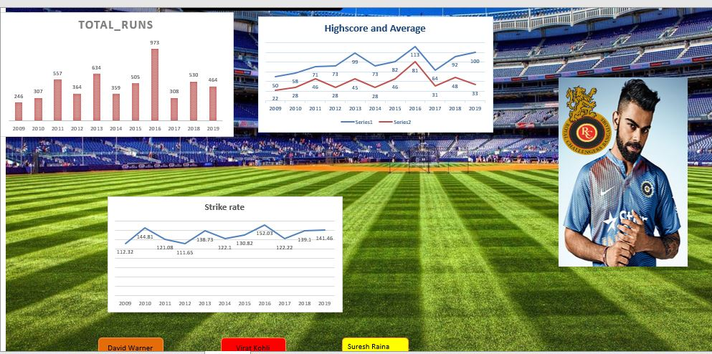
WEEK 0
IPL DASHBOARD
TAKE AWAY POINTS
1. How we should select the feature for our Data story.
2. How to understand the problem statement first before jumping to the data visualization..
3. Understand what is required for data story..

Slide 3
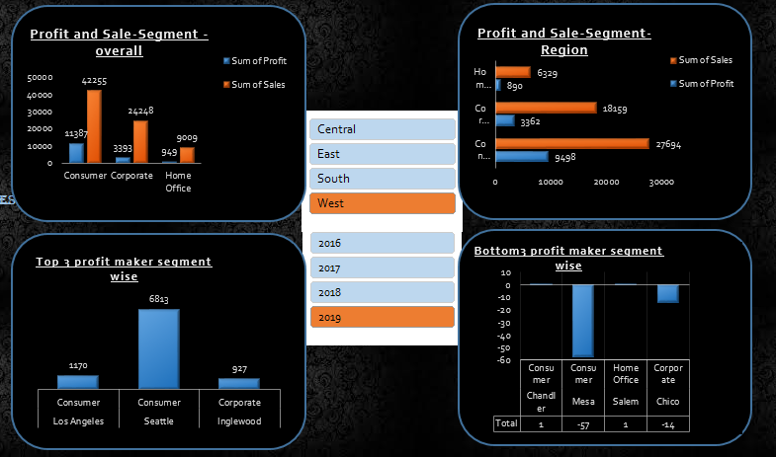
WEEK 1
US SUPERSTORE DASHBOARD
TAKE AWAY POINTS
1.Understand the motive behind the dashboard..
2.Understand your audience..
3.Keep things more simple and clear..
4.Focus on symmetry..

Slide 4
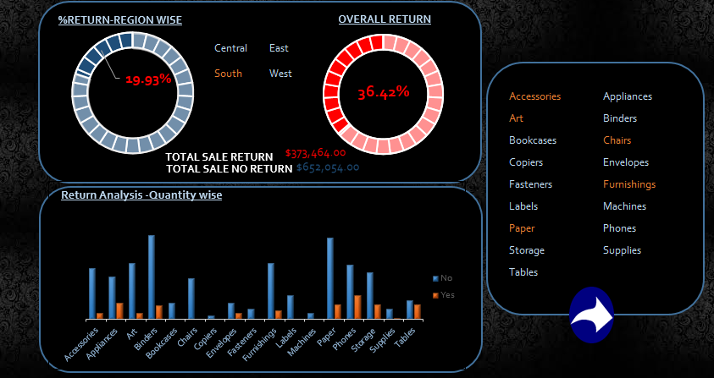
WEEK 2
WHAT – IF ANALYSIS ON WEEK 1
TAKE AWAY POINTS
1. Difference between data type
2. Identifying different types of opportunity analysis
3. identify Hierarchy present in the data
4. Use KPIs that has sufficient data to back it

Slide 5
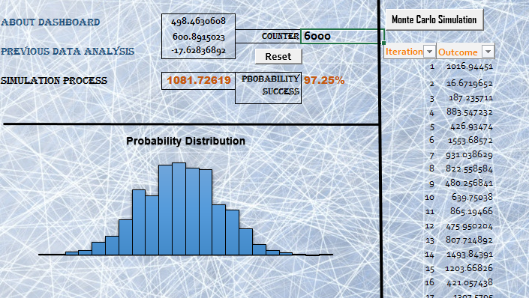
WEEK 3
MONTE CARLO SIMULATION
TAKE AWAY POINTS
1. Keep things simple, don't make it completed by jumping on data.
2 Always make story first in story note with clarity then go to excel & data.
3. Always come with story, No matter how beautiful it is.
4. Just keep default theme colours in chart,

Slide 6
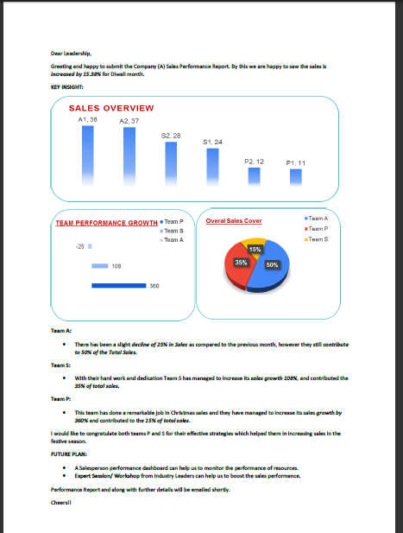
WEEK 4
EMAIL YOUR ANALYSIS REPORT TO MANGAMENT
TAKE AWAY POINTS
1. How much money you will loose if you don't get the data analysis.
2. Your Dashboard should always convey your strategy in dollar.
3. Attune your strategy based on the problem statement/audience.
4. How triangular concept can help you to make your data story.
5. How you should follow the hierarchy for your data story.

Slide 7
Thank You !!
Special thanks to Saurabh Sir and Preksha Ma’am ..
Cheers!!

